Slide 1
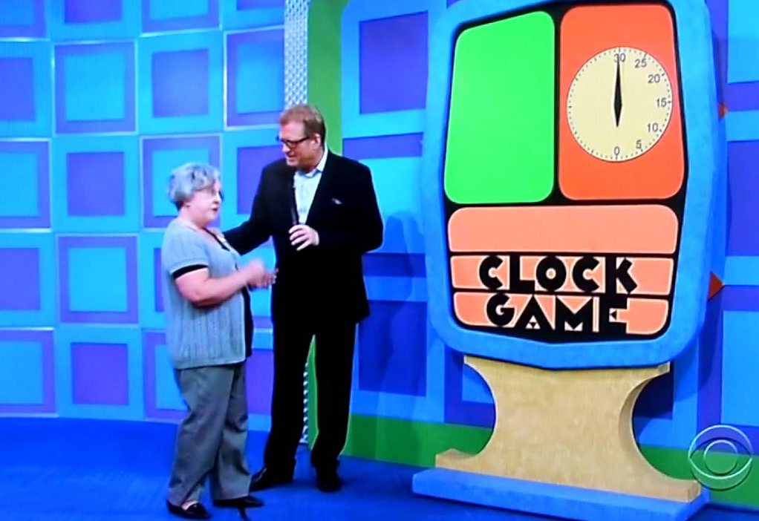
Hi/Lo Web App
https://www.youtube.com/watch?v=nHBZzCqS9nI

Slide 2

Tinkering
Type in the hi/lo game example.
Try asking the user for a name at the beginning. How can you use this to separate concurrent games?
Create a high-scores table that shows on the first page.

